Slide 1

RIZVI COLLEGE OF ENGINEERING
ELECTRONICS ENGINEERING

Slide 2
TOPIC: SMART MONITORING TECHNOLOGY
Presented By:
Abbas Ali Haldar (08)
Rahim Korbo (14)
Shahrukh Padaniya (20)
Vishal Kerkar (10)
Guide
Dr.Varsha Shah

Slide 3
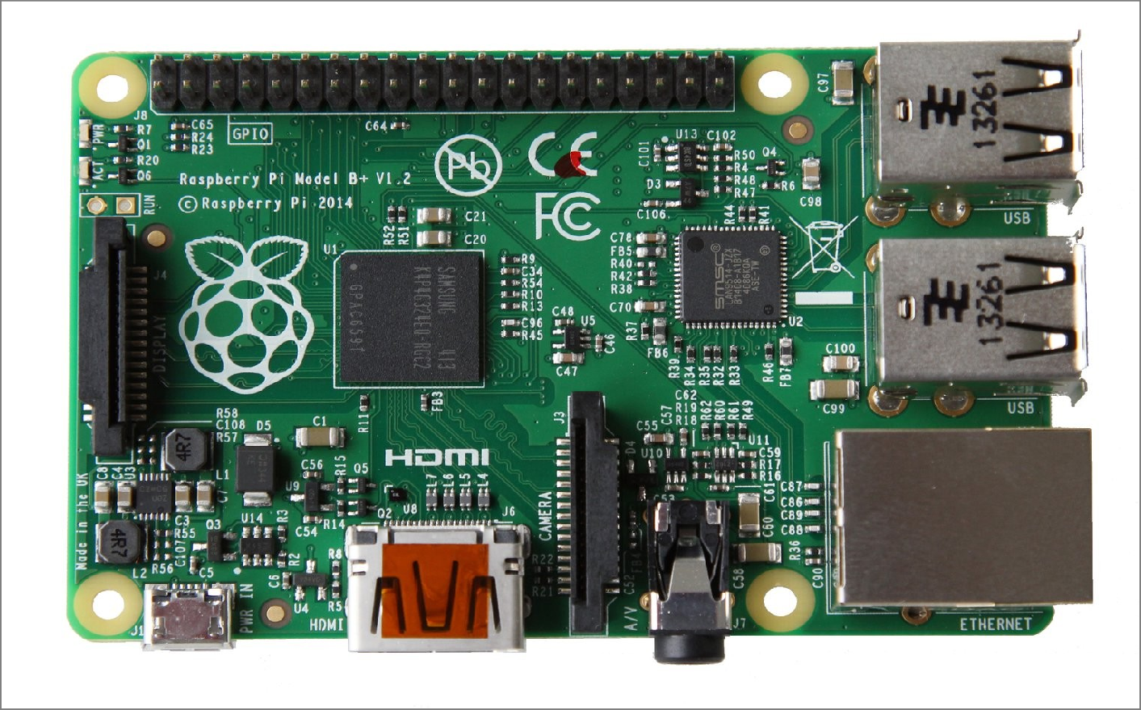
SMART MONITORING TECHNOLOGY USING RASPBERRY PI

Slide 4
ABSTRACT
This project deals with the design and implementation of Smart surveillance monitoring system using Raspberry pi. It uses wireless technology to provide essential security using surveillance system. The proposed security system captures information and transmits it via a WiFi to a static IP, which is viewed using a web browser from any smart device. Raspberry pi controls a video camera for surveillance. It streams live video and records the motion detected parts in the cloud and/or in the windows shared folder for future playback. The cameras automatically initiate recording when motion is sensed and the Raspberry pi device stores it in a secured folder.

Slide 5
INTRODUCTION
Authenticity is an important factor in various field. E.g., defense, data storage, economy sector.
Due to exponential rise in burglary and theft activities, surveillance system are providing to be great source of security.
In this project we are on for making the word authenticity true in the form of these dedicated project of smart surveillance.
These surveillance system is low cost and user friendly too.

Slide 6
ADVANTAGES OVER EXISTING SYSTEM
•
In CCTV systems there should be a dedicated PC for the module which is eliminated here.
A PC can be hacked and the files can be erased while this system overcomes those problems.
In this system, authentication is required on the user side inorder to view the streamed video in the browser.
Very less expensive when compared to the other existing systems. In this system, a wide area can be captured.
The camera motion can be controlled by the user.
•
•
•
•
•

Slide 7
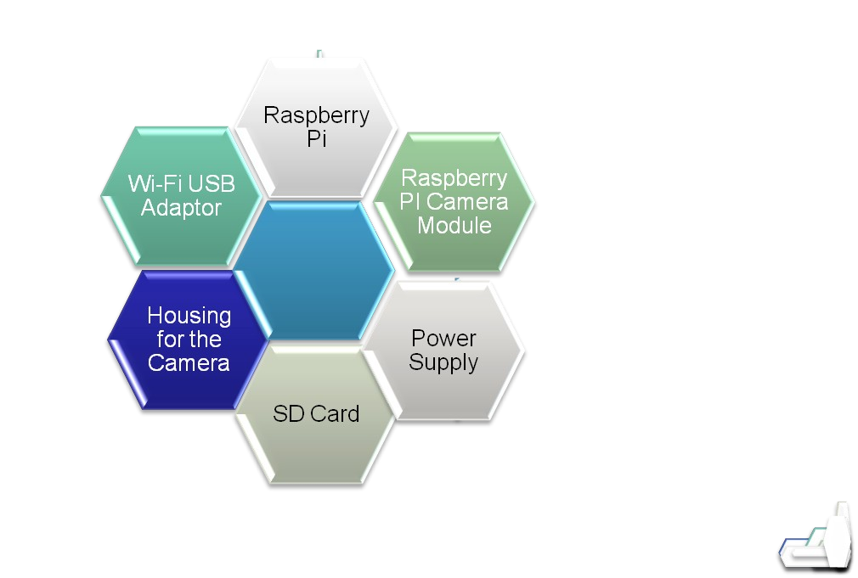
COMPONENTS USED

Slide 8
TECH USED
SR NO. | NAME | TYPE
1. | RASPBERRY PIE | HARDWARE
2. | PIE CHARGER | HARDWARE
3. | WEBCAME | HARDWARE
4. | MEMORY CARD – 16gb | HARDWARE
5. | CONNECTOR WIRE FOR PIE | HARDWARE
6. | MONITORING DEVICE | HARDWARE
7. | EDIMAX WIFI USB ADAPTOR | HARDWARE
8. | OPEN CV | SOFTWARE
9. | PYCHARM COMMUNITY | SOFTWARE

Slide 9
BLOCK DIAGRAM
TRAINING DATASET
MOTION DETECTED
CAPTURE IMAGE
PROCESS IMAGE
UNAUTHORIZED PERSON?
YES
GIVES INFORMATION
NO
NO NOTIFICATION

Slide 10
Programs used in the project 1. Data Generator 2. Data Trainer 3. Data Detector

Slide 11
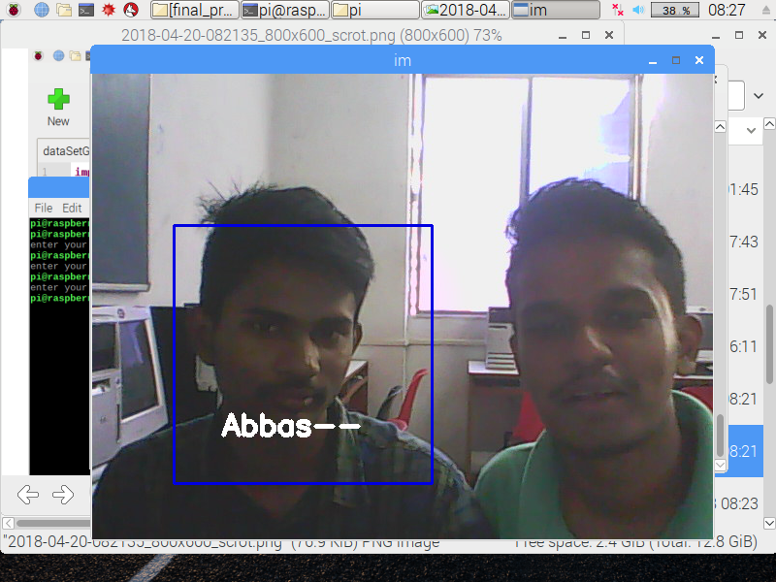
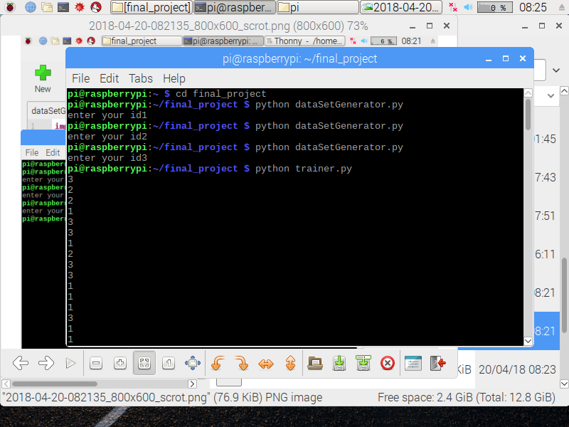
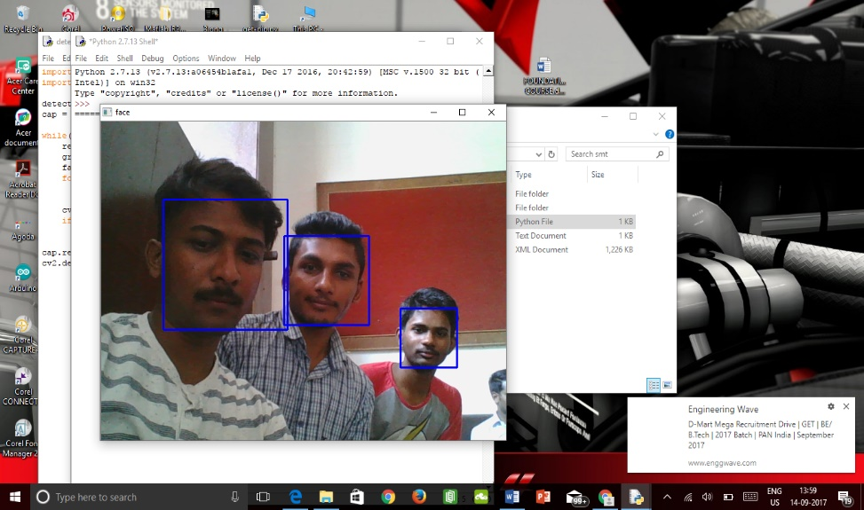
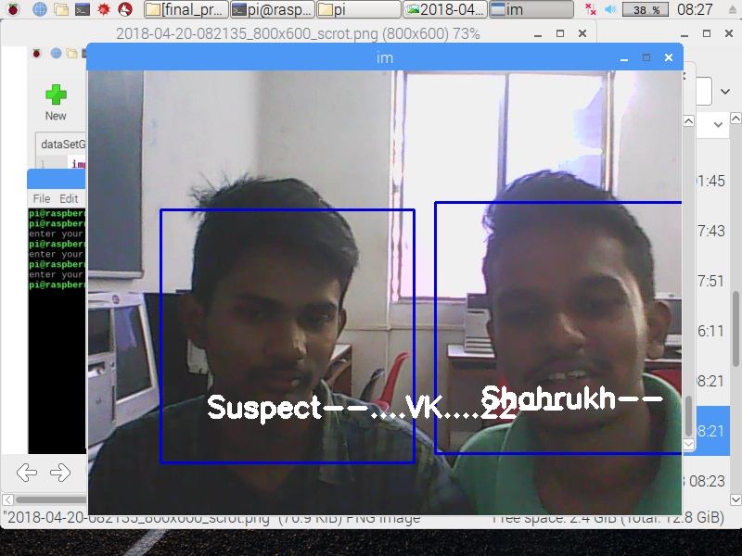
OUTPUT IMAGE CAPTURED

Slide 12
ADVANTAGES:
By using this smart surveillance monitoring technology, we can identify theft or a bugler.
We can also use this technology for searching any missing person.
We would get notification through SMS or Email, whenever a required person is identified by the system.
This system provides about 90% accuracy.

Slide 13
DISADVANTAGES:
Raspberry pie cant work continuously as it would get heated up by the processing load.
Accuracy of the system decreases in dark.
Continuous power supply is needed for raspberry pie and the system needs to be secured.
We can just get notification about theft, but cant control the act.
If there is any close resemblance between two person, there may occur error in detection by the system.

Slide 14
Future Scope:
WE HAVE CHOSEN THIS PROJECT WITH THE INTENTION THAT IT WILL BE VIABLE FOR FUTURE USE.RASPBERRY PI DEVELOPMENT BOARD IS A COST EFFECTIVE FULLY FUNCTIONAL COMPUTATIONAL SYSTEM CAN BE USED FOR MANY APPLICATIONS. PIR MOTION SENSOR AND CAMERA MODULES ARE ALSO COST EFFECTIVE AND CAN BE USED FOR SURVEILLANCE SYSTEMS.
USING PYTHON AND OPENCV IN RASPBERRY PI, MADE OUR PROJECT FLEXIBLE AND ADOPTABLE TO ANY REQUIRED FUTURE CHANGES. DETECTED FACES CAN BE STORED IN CLOUD AND CAN BE USED FOR RECOGNIZING THE FACES IS THE FUTURE SCOPE.
USING RASPBERRY PI THECURRENT PROJECT CAN BE MODIFIED BY AN INFRARED CAMERA INTERFACING IT CAN BE USED IN SMART SURVEILLANCE MONITORING SECURITY SYSTEM WHICH ANY TYPE OF PUBLIC SECURITY IS USING LIVING BODY DETECTION OR SPYING
ALSO IT CAN BE USED IN ATTENDANCE SYSTEM OF THE CLASS, ALSO SOME PROFOUND APPLICATIONS CAN BE IMPLEMENTED USING INTERFACING OF RASPBERRY PI AND ARDUINO UNO BOARD LIKE SENSOR APPLICATION OF SMARTCARD SWAPPING, FINGER DETECTION, ALCOHOL DETECTION, AGRICULTURE HUMIDITY SENSING, TEMPERATURE SENSING USING WEBSERVER, AND MANY MORE.

Slide 15
CONCLUSION
•
There are a thousand things we can do with such a surveillance cam basic setup now.
Sending Growl notifications when some motion was detected
Or we could easily add a temperature-sensor to the cam and can be integrated very easily.
If you want extra security, you could also add a battery pack to the camera. The one that is able to charge simultaneously while powering the Raspberry. This would enable you to detect if some bad guy cuts the power strips of your camera and send some alert messages to you (i.e. SMS or email) including the video of the disturber.
•
•
•

Slide 16
THANK YOU

